Slide 1


AI-Based Crop yield Production and Optimization
CAPSTONE PRESENTATION
CSA0624 – DESIGN AND ANALYSIS OF ALGORITHM
Done By:
Student Name – Roshan. K
Register Number 192425014
Supervisors
Dr GNANAJEYARAMAN RAJARAM
SIMATS Engineering

Slide 2
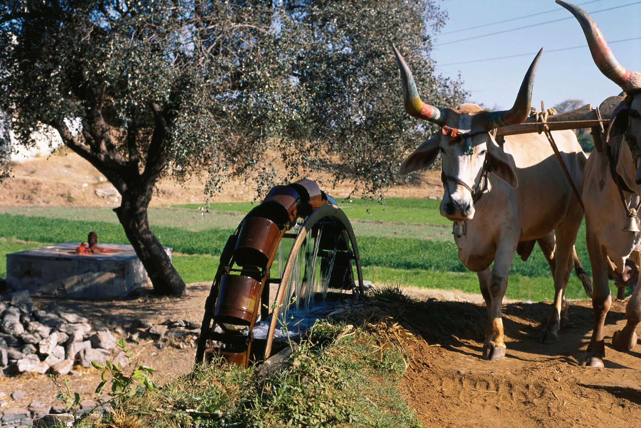
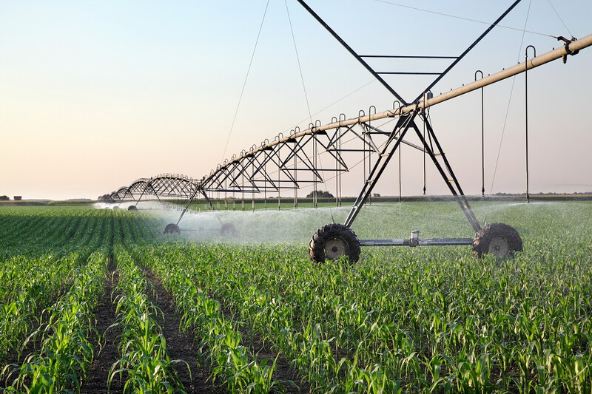
INTRODUCTION
Background & Motivation
Agriculture heavily depends on proper irrigation and suitable crop selection for optimal yield.
Traditional irrigation practices are inefficient and often lead to water wastage.
Efficient water management is critical for sustainable agriculture.

Slide 3
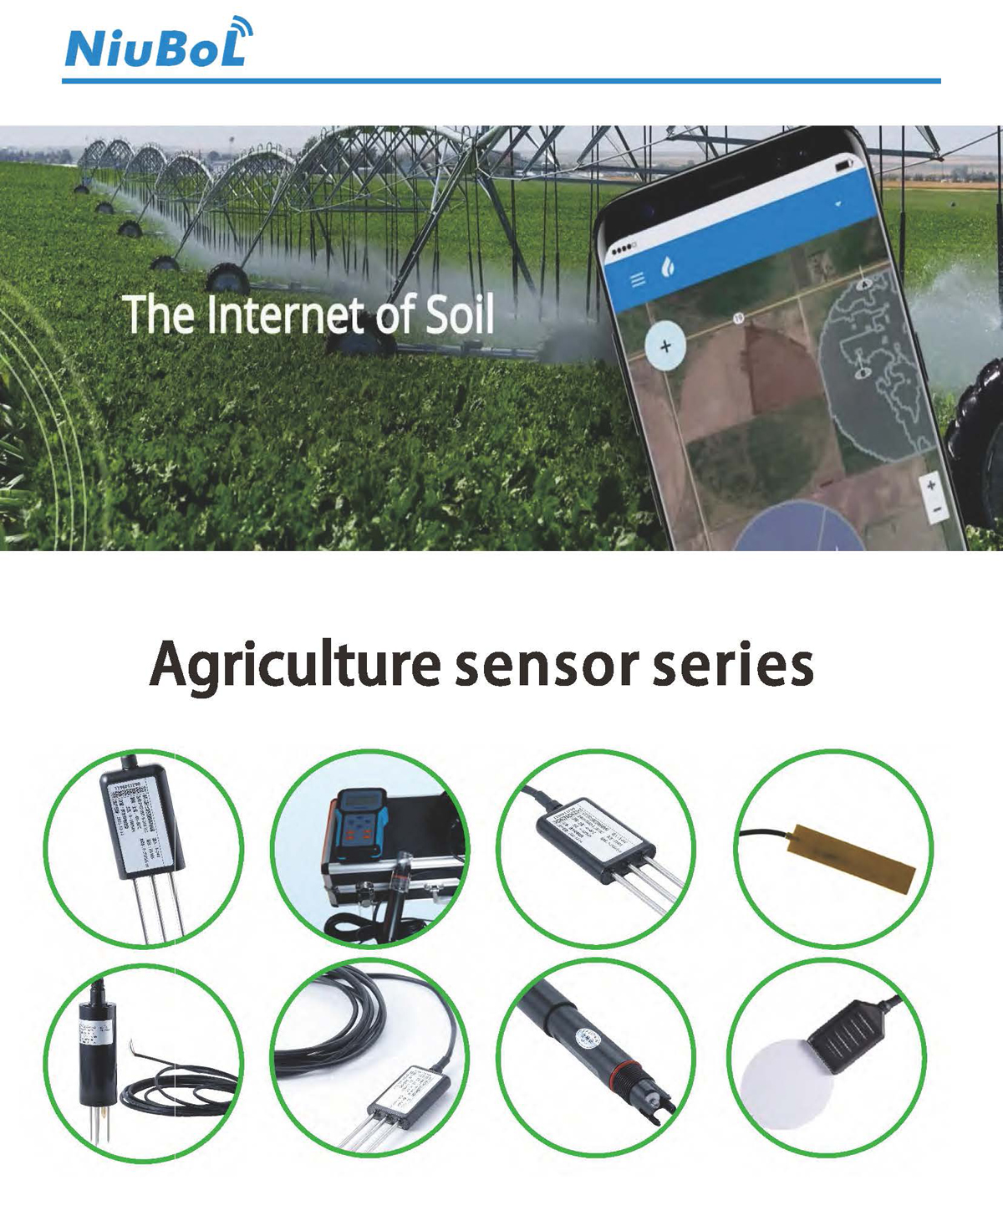
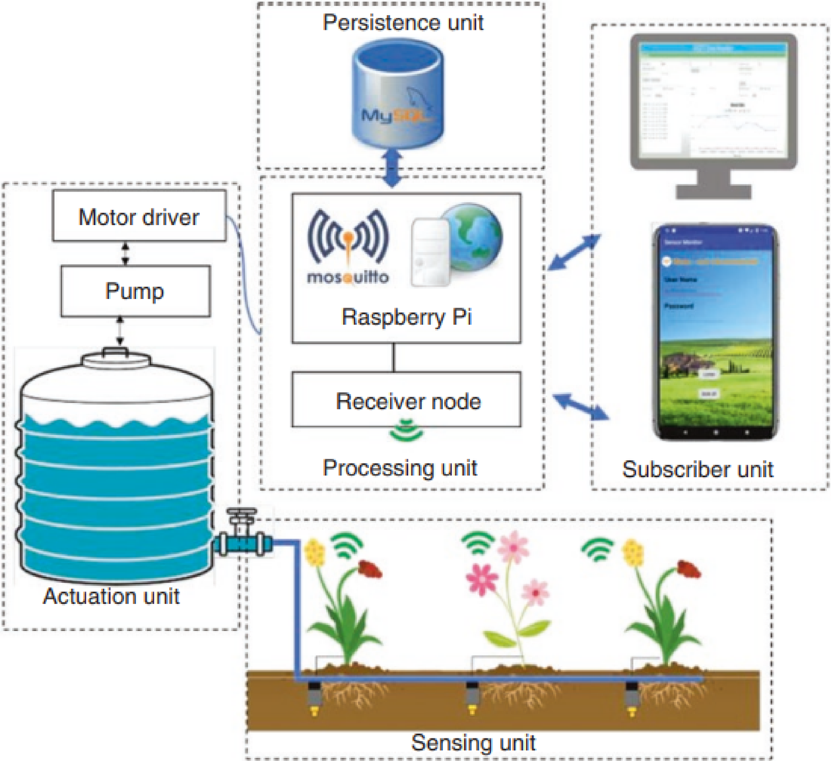
INTRODUCTION
Technology-Driven Solution
Advancements in IoT enable real-time monitoring of environmental parameters.
Machine learning techniques provide data-driven decision-making in agriculture.
Integrating IoT with ML helps predict irrigation needs and recommend suitable crops.
This project focuses on precision farming using smart irrigation techniques.

Slide 4
LITERATURE REVIEW
Sl. No | Year of Publication | Authors | Title of the Publication | Findings | Limitations
1 | 2021 | S. S. Patil, R. H. Kulkarni, A. P. Deshmukh | IoT-Based Smart Irrigation System Using Machine Learning | ML models improved irrigation efficiency using soil moisture data | Limited crop recommendation capability
2 | 2022 | A. Sharma, N. Gupta, R. Verma, S. K. Singh | Crop Recommendation System Using Machine Learning Techniques | Naïve Bayes and Decision Trees effectively predicted suitable crops | Did not include real-time IoT data
3 | 2023 | P. Ramesh, K. Senthil, M. Aravind, L. Karthik | Smart Agriculture Using IoT and K-Means Clustering | K-Means clustering helped in zoning agricultural fields | No irrigation prediction model used
4 | 2024 | R. Verma, S. Malhotra, P. Choudhary | PCA-Based Feature Reduction for Smart Farming Systems | PCA reduced data redundancy and improved model performance | Focused only on data analysis, not control
5 | 2025 | A. Kumar, V. Rajesh, M. N. Prasad, S. Balaji | Machine Learning-Based Irrigation and Crop Recommendation System | Combined supervised and unsupervised learning improved accuracy | High dependency on sensor reliability

Slide 5




LITERATURE REVIEW

Slide 6
PROPOSED WORK
WORK OVERVIEW:
An ESP8266-based smart irrigation and crop recommendation system is proposed.
The system integrates IoT sensors with machine learning techniques.
Real-time environmental data is continuously monitored and processed.
The system aims to optimize water usage and improve crop selection.
Data Acquisition & Preprocessing
Soil moisture, temperature, and humidity sensors collect real-time field data.
ESP82 is used for data acquisition and wireless communication.
Collected data is cleaned, normalized, and prepared for analysis.
Preprocessed data is forwarded to machine learning modules.

Slide 7
PROPOSED WORK
Machine Learning & Decision Making
PCA is applied to reduce data dimensionality and remove redundancy.
K-Means clustering is used to identify different field zones.
Linear Regression predicts the irrigation water requirement.
Naïve Bayes recommends suitable crops based on environmental conditions.

Slide 8
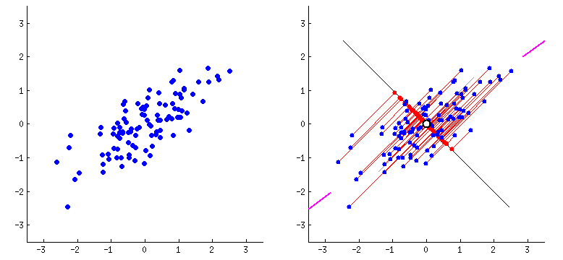
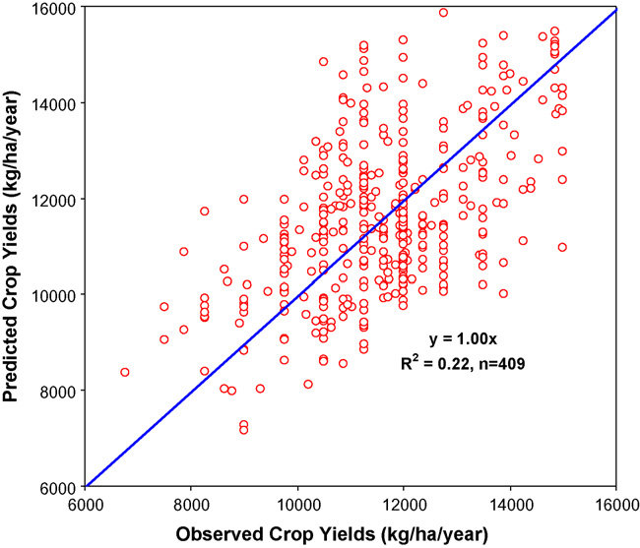
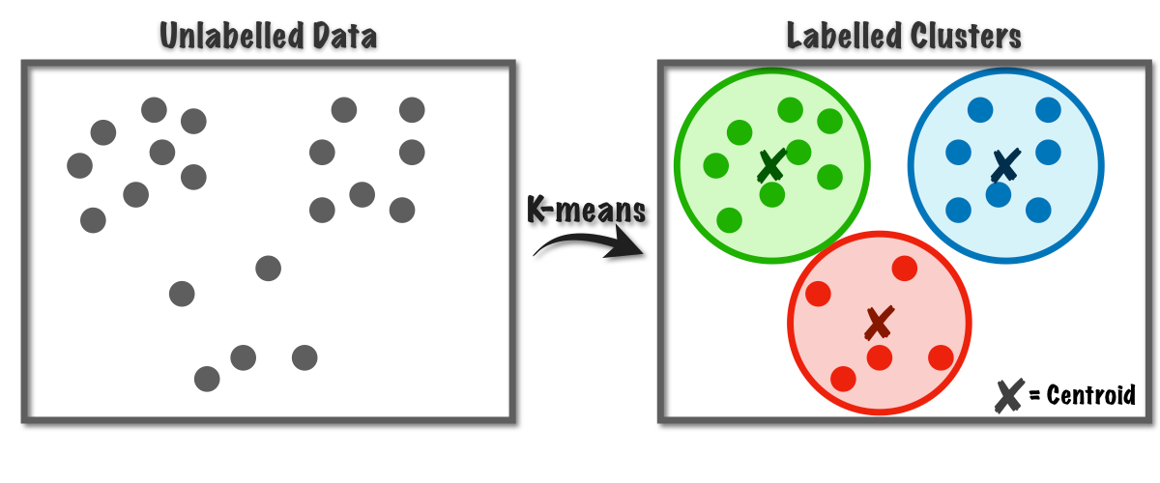
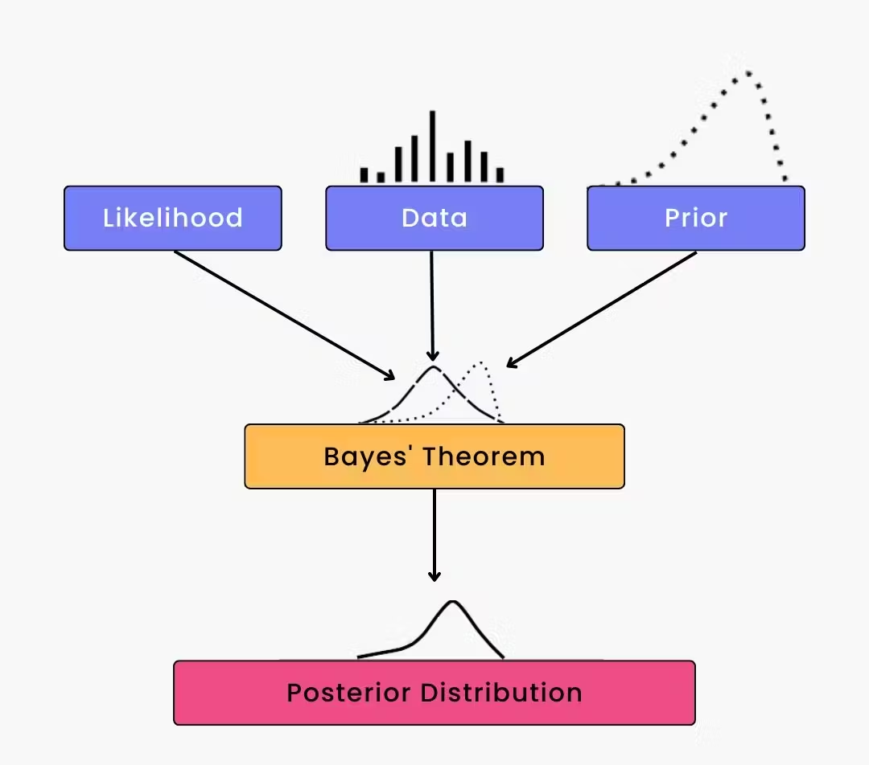
PROPOSED WORK
Why PCA is used in Smart Farming?
Smart farming systems collect lots of sensor data:
Soil moisture
Temperature
Humidity
pH
N, P, K values
Rainfall
Light intensity
Why Naïve Bayes is used in Smart Farming?
Fast
Works well with small datasets
Performs well for classification problems
Why Linear Regression is used?
Simple
Interpretable
Ideal for prediction and forecasting
Why K-Means is used in Smart Farming?
No labeled data needed
Helps group similar soil or climate regions
Useful for decision zones

Slide 9
RESULTS & DISCUSSION
Overall System Performance
The proposed system successfully integrates IoT and machine learning techniques.
Real-time environmental data is effectively processed for decision-making.
The system provides irrigation prediction, crop recommendation, and field zoning.
Automated decision support improves farming efficiency.

Slide 10
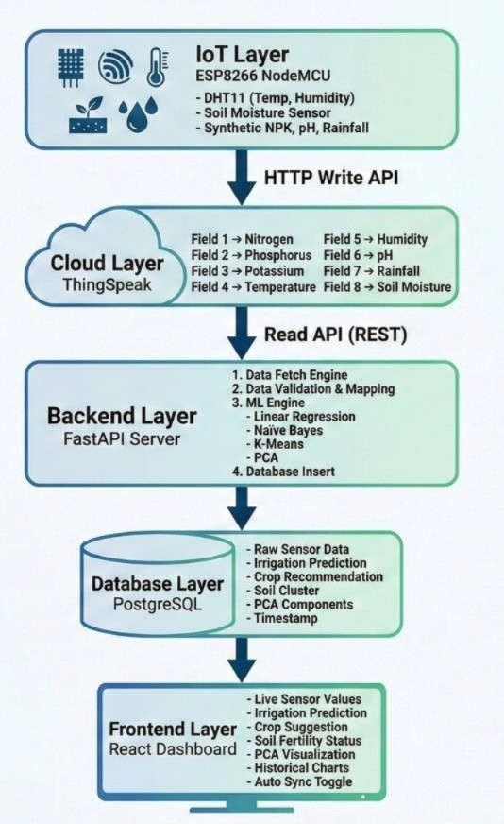
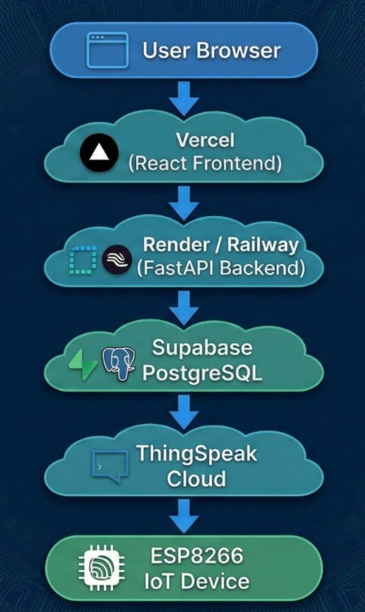
SYSTEM ARCHITECTURE

Slide 11
CONCLUSION
The proposed system demonstrates the effective use of IoT and machine learning in smart agriculture.
Real-time sensor data enables accurate prediction of irrigation requirements.
Machine learning techniques help in identifying field zones and recommending suitable crops.
Automated irrigation control reduces water wastage and improves efficiency.
The system supports precision farming and promotes sustainable agricultural practices.

Slide 12
REFERENCES
[1] S. S. Patil, R. H. Kulkarni, and A. P. Deshmukh, “IoT-based smart irrigation system using machine learning,” in Proc. Int. Conf. Smart Technologies for Smart Nation (SmartTechCon), IEEE, 2021, pp. 112–117.
[2] A. Sharma, N. Gupta, R. Verma, and S. K. Singh, “Crop recommendation system using machine learning techniques,” in Proc. Int. Conf. Advances in Computing, Communication and Control, IEEE, 2022, pp. 245–250.
[3] P. Ramesh, K. Senthil, M. Aravind, and L. Karthik, “Smart agriculture using IoT and K-means clustering,” in Proc. IEEE Int. Conf. Intelligent Systems and Control (ISCO), 2023, pp. 98–103.
[4] R. Verma, S. Malhotra, and P. Choudhary, “PCA-based feature reduction for smart farming systems,” IEEE Access, vol. 12, pp. 45678–45685, 2024, doi: 10.1109/ACCESS.2024.
[5] A. Kumar, V. Rajesh, M. N. Prasad, and S. Balaji, “Machine learning-based irrigation and crop recommendation system,” in Proc. IEEE Int. Conf. Artificial Intelligence and Smart Agriculture, 2025, pp. 301–306.

Slide 13
A Smart Irrigation and Crop Recommendation System Using Linear Regression, Naïve Bayes, K-Means Clustering, and PCA
THANK YOU

